Slide 1

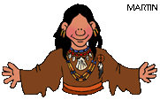
Using the 5 Themes of Geography to study the lives of Native Americans
Learning Goal:
What are the 5 themes of geography?
AN INTERACTIVE LEARNING MODULE
Made by: Mrs. Jodie Stoltenow
Adapted by Ms. Meller

Slide 2

DEFINITION OF GEOGRAPHY
ge·og·ra·phy
1 : a science that deals with the description, distribution, and interaction of the diverse physical, biological, and cultural features of the earth's surface
Source-Merriam Webster Collegiate Dictionary

Slide 3


IN PLAIN ENGLISH
Geography is the study of the earth and everything on it.

Slide 4
Introducing the 5 Themes
of Geography
Place
Regions
MOVEMENT
Human
Environment
Location

Slide 5

WHERE DID THE 5
THEMES COME FROM?
The 5 Themes of Geography originated by the National Geographic Society to fulfill a need for geographers (people who study the earth and everything on it)

Slide 6
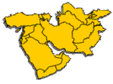



5 THEMES OF GEOGRAPHY
Visit each of the following sites. Follow all buttons on each page. Save the BACK ARROW button until you are done with each page. The BACK ARROW button will bring you back to this page. When you have visited all 5 Themes, click on the RIGHT arrow button below.
MOVEMENT
REGION
Human-Environment
LOCATION
PLACE

Slide 7
Movement includes the movement of people, things, such as goods, as well as communications (the movement of ideas).
We can describe the type of communications a place has and the main forms of transportation, as well as what goods are exported and imported. These all come under the heading of movement.

Slide 8
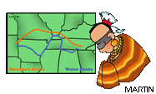
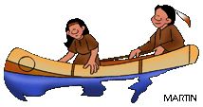
MOVEMENT
Things to think about.
How did the Native Americans get to the continent of North & South America?
What kind of goods did Native Americans trade?
Where did they trade goods and ideas?
What did they use for transportation?
Why did tribes travel or move?

Slide 9
REGION
The world is divided into different areas based upon similarities & differences.
  Climate
  Location
  Beliefs
  Languages
  Ethnicity/Race
  Types of Governments

Slide 10
Region
What are some different regions you can think of?

Slide 11
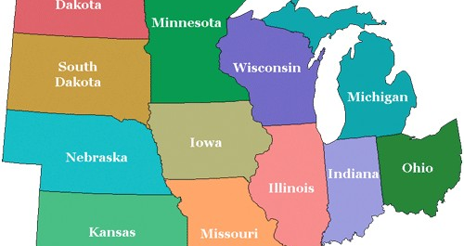
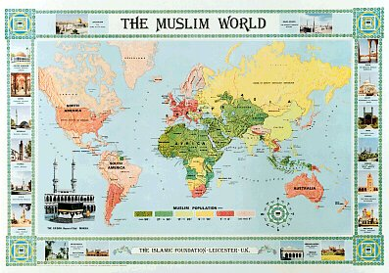
Examples

Slide 12
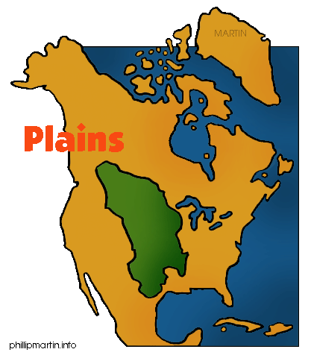

REGION-Things to think about.
What are the different regions of Native Americans?
What is similar in the physical features of the area?
What tribes live in particular regions?
What languages are spoken?
What is their religion?

Slide 13

HUMAN-ENVIRONMENTAL
This is about the relationship between people and their environment, or how they work together.
It can be divided into 3 parts:
1.) How people have been changed by the environment.
2.) How the environment has been changed by people.
3.) How people depend on the environment.

Slide 14
Interaction
The environment & people are interconnected.
Consequences to those actions depend upon how people choose to interact with the world and use their resources.
  Positive/Negative
  Intentional/Accidental

Slide 15
Interaction
What are some positive and negative interaction that people have done to the environment?
What about intentional or accidentally?

Slide 16
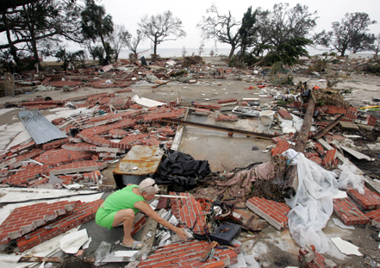

Slide 17



Human-Environmental
Things to think about
What effects did the Native Americans have on their environment?
Positive
Negative
How has the environment affected them, do they depend on it for anything?
Shelter
Water
Food
Clothing
What changes have they made to their environment to make it easier to live in?

Slide 18
LOCATION
Absolute: can also be called specific
*Here are some examples:
1.)Street Address:
  2501 Silly Street,
      Anywhere Town, Nowhere Place
  2.)A Map Address:
  15º20' North, 20º15' West
*Both of these examples well tell you exactly where a place is.

Slide 19
Relative: can also be called general
*Here are some examples:
  1.)ten minutes away by train
  2.)in front of the bank
*General location is shown by saying where something is in relation to somewhere or something else.

Slide 20

LOCATION
Things to think about.
Where were the different Native American Regions or tribes located?
A location can be specific (for example, it can be stated as coordinates of longitude and latitude or as a distance from another place) or general (it's in the Northeast).
What were the tribes’ locations in relation to other major tribes?
What geographic factors caused the tribes to be located where they were? (e.g. land, water)

Slide 21
PLACE
It is a description of what makes that place different to others.
Physical differences, or characteristics,
mountains, rivers,
type of soil, wildlife,
climate, etc.
Human differences, or characteristics,
roads buildings
how people live traditions

Slide 22
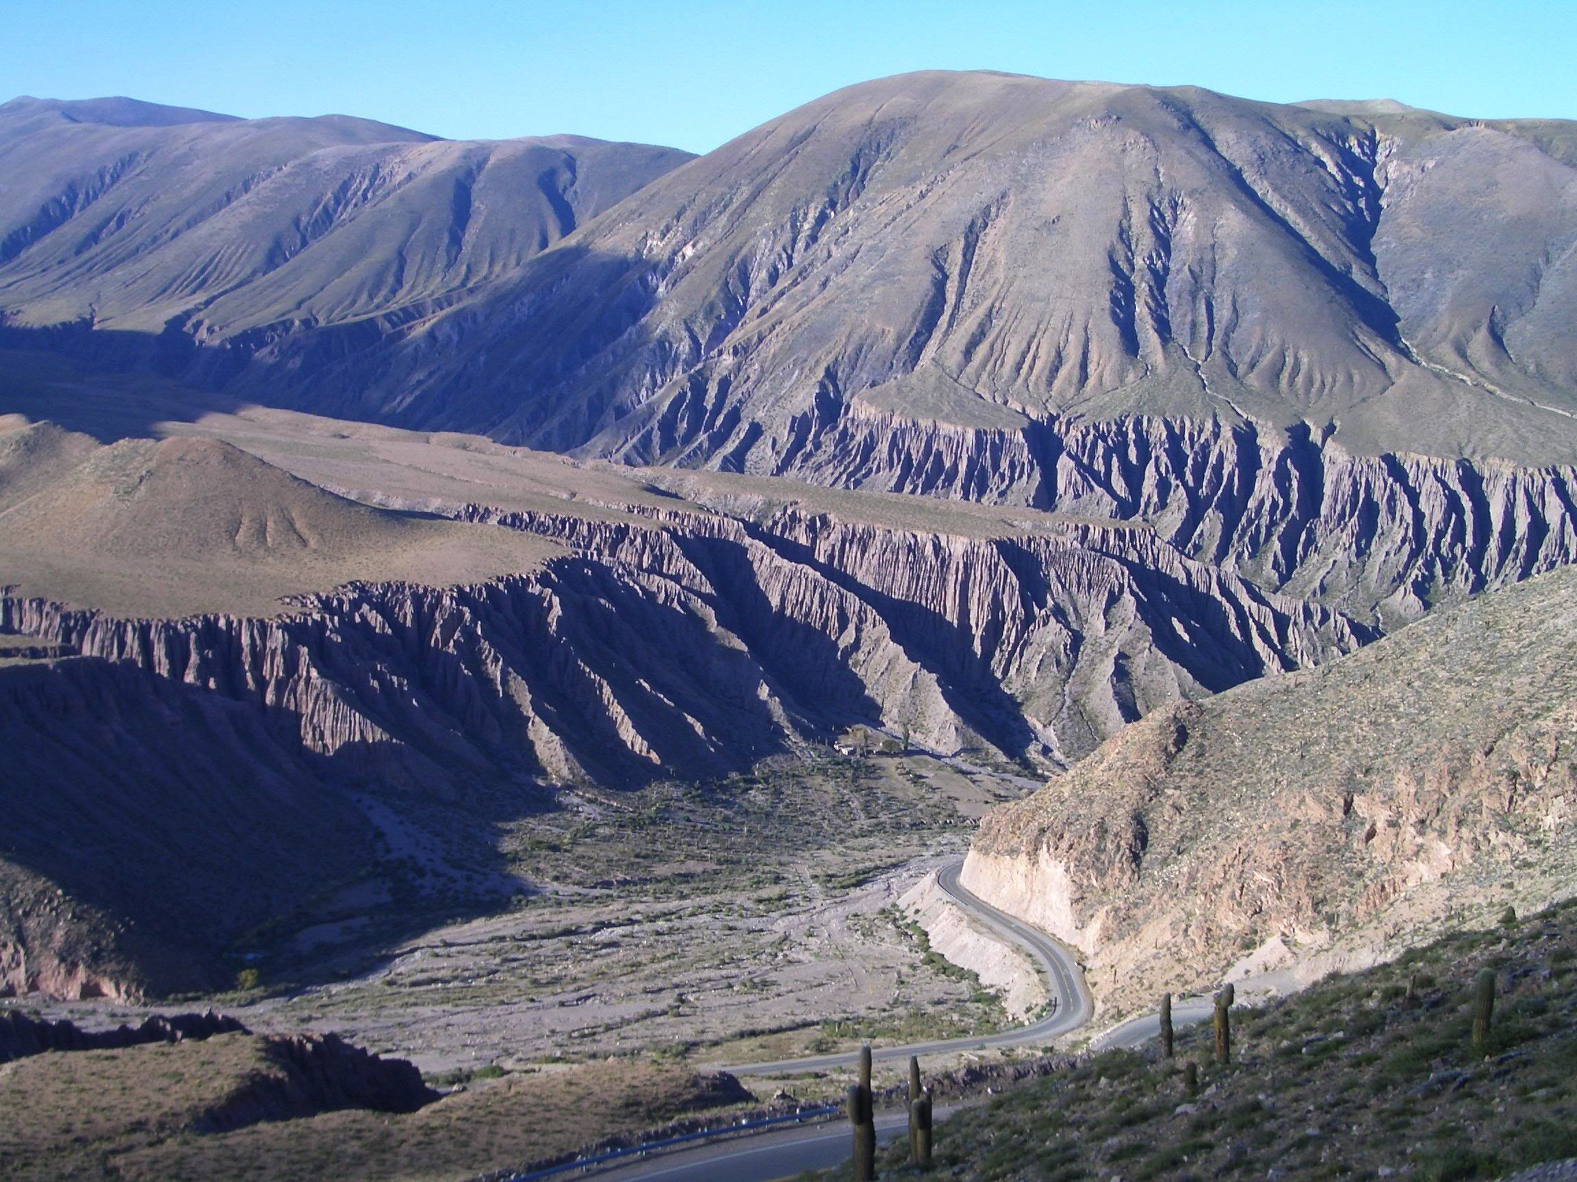
Physical Characteristics
Specific to THAT place, not generic.
  The way a place looks.
Created by nature.
  Mountains
  Rivers, Lakes, Seas
  Climate
  Vegetation
Examples:
  Andes Mountains are in South America.
  Amazon River flows through Brazil.
  Pampas are located in Argentina.
  CCA is surrounded by a flat area

Slide 23
Cultural Characteristics
Specific to THAT place, not generic.
  Peoples activities change the way a place looks or is represented.
Man-made or invented.
  Language
  Unique buildings
  Religious Practices
  Celebrations/traditions/holidays
Examples:
  Portuguese is the official language of Brazil.
  Many Mexicans are Catholic.
  Mayan ruins are located in Mexico.
  Blue & White are the Colors and Clipper is the mascot

Slide 24

PLACE
Things to think about
What makes a place different from other places?
What was the climate, and how did it effect the tribe?
What physical features were found in a specific region?
What was the tribe who live there like?
What were their traditions?

Slide 25
To remember the 5 themes think Mr. Help
M Movement
R Region
H
E Human/Environment
L Location
P Place

Slide 26

Question 1
Which of the following is NOT a geography theme?
A. movement
C. region
B. human-environmental interaction
D. people

Slide 27
Question 2
Which of the following is an example of Human-Environmental Interaction?
A. getting the mail
C. playing Gameboy
B. watching TV
D. Rainforest Clearing

Slide 28
Question 4
Which of the following is an example of PLACE?
A. Deep South
C. Dodge County Middle School
B. McDonalds
D. Skating rink

Slide 29

Question 5
Which of the following is an example of Location?
B. Dodge County Middle School
1103 Herman Ave
Eastman, GA 31023
D. the hills
A. Springfield, Missouri
C. Georgia

Slide 30
Question 6
Which of the following is an example of region?
A. Georgia
C. United States
B. South America
D. The Midwest

Slide 31
Question 7
What is the name of a person who studies the earth and everything on it?
A. Photographer
C. Geographer
B. Cartographer
D. Mapographer

Slide 32
Examples
Let’s look at the 5 themes for geography for CCA
  Place: Physical & Cultural
  Movement
  Region
  Interaction
  Location: Absolute & Relative

Slide 33
Example
In pairs please think of examples for each of the themes,
  You have 5 minutes get to it!

Slide 34
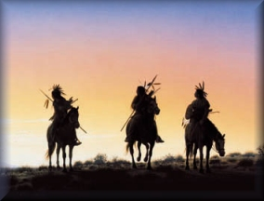
MAKING SENSE OF IT ALL:
Now you have learned how geographers study the earth. Pretend you are a geographer recently landing in the new world. Using the graphic organizer provided, use the five themes to learn more about one particular region of American Indians. Be prepared to share your findings with other geographers when you return.

Slide 35
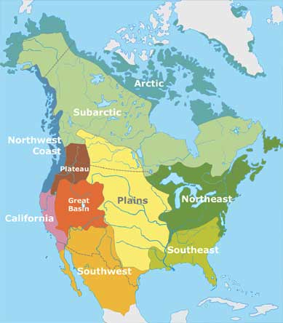
Native American Tribes

Slide 36
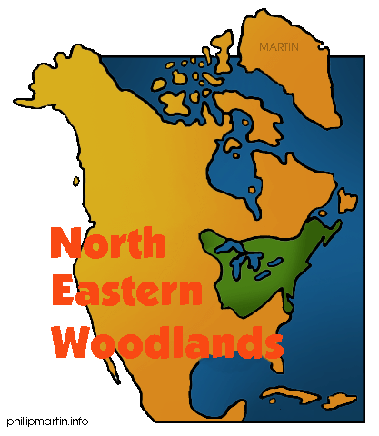
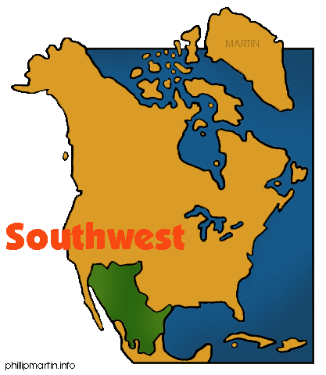
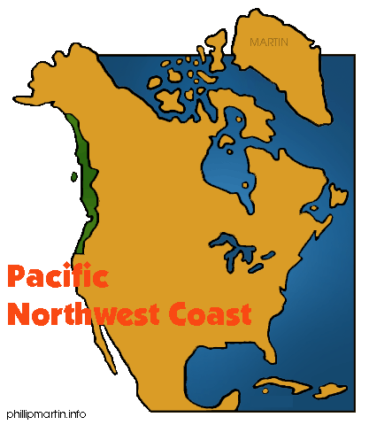
Click on the picture of the tribe your group has chosen to research. Use the websites at that page to complete the web graph provided.

Slide 37
http://www.ahsd25.k12.il.us/Curriculum%20Info/NativeAmericans/woodlandtribes.html
http://nativeamericans.mrdonn.org/northeast.html
SHELTER
http://www.mnsu.edu/emuseum/prehistory/settlements/
Tribes by state: http://www.kstrom.net/isk/maps/usmapindex.html
Early Tribal Histories
http://www.tolatsga.org/Compacts.html
Clothing by region
http://www.nativetech.org/clothing/regions/regions.html

Slide 38
http://inkido.indiana.edu/w310work/romac/plains.html
http://www.nhusd.k12.ca.us/ALVE/NativeAmerhome.html/Cheyenne/cheyenne.html
SHELTER
http://www.mnsu.edu/emuseum/prehistory/settlements/
Tribes by state: http://www.kstrom.net/isk/maps/usmapindex.html
Early Tribal Histories
http://www.tolatsga.org/Compacts.html
Clothing by region
http://www.nativetech.org/clothing/regions/regions.html

Slide 39
http://www.nhusd.k12.ca.us/ALVE/NativeAmerhome.html/Navajo.html/Navajo_Home_Page.html
SHELTER
http://www.mnsu.edu/emuseum/prehistory/settlements/
http://www.greatdreams.com/native/nativehsg.htm
http://inkido.indiana.edu/w310work/romac/swest.htm
Tribes by state: http://www.kstrom.net/isk/maps/usmapindex.html
Early Tribal Histories
http://www.tolatsga.org/Compacts.html
Clothing by region
http://www.nativetech.org/clothing/regions/regions.html

Slide 40
http://inkido.indiana.edu/w310work/romac/nwindian.htm
http://www.nhusd.k12.ca.us/ALVE/wow/Northwest%20Cultures/northwest.htm
SHELTER
http://www.mnsu.edu/emuseum/prehistory/settlements/
Tribes by state: http://www.kstrom.net/isk/maps/usmapindex.html
Early Tribal Histories
http://www.tolatsga.org/Compacts.html
Clothing by region
http://www.nativetech.org/clothing/regions/regions.html

Slide 41
Good Job!
REFERENCES
http://www.funsocialstudies.learninghaven.com/articles/fivethemes.htm
http://www.education-world.com/a_lesson/lesson071.shtml
http://www.classbrain.com/artaskcb/publish/article_34.shtml

Slide 42
Work Cited
http://desizntech.info/2009/03/spice-up-your-desktop/
http://outdoors.webshots.com/photo/2128068680090293398QoyWIW

