Slide 1
Andrew Jackson
America’s Blessing or Curse?

Slide 2
“I was born for a storm, and a calm does not suit me.” Andrew Jackson

Slide 3
James Parton: Jackson’s Biographer
“So difficult is it to attain information respecting a man whom two thirds of his fellow citizens deified (thought he was like a God), and the other third vilified (thought he was America’s greatest villain).”

Slide 4
Essential Question
Was Andrew Jackson a good president or bad president?

Slide 5
Context
Andrew Jackson was president between 1829 and 1837 and was known as the “People’s President”.
He was a Democrat- Republican.
He ran for president on the platform that the Federal Government needed reform. Jackson argued the Federal Government was only helping the elites and needed to be opened up to help the average American.
The policies he pursued did both profound good and lasting harm to the America’s economy and government, making Andrew Jackson one of America’s most controversial Presidents.

Slide 6
What are we going to look at?
Presidential Veto and Spoilage System.
Kitchen Cabinet.
End of America’s National Bank and the Paying off of America’s debt.
Holding the Union together during the Nullification Crisis.

Slide 7
Expansion of Presidential Power
Spoils System
Presidential Veto
Every President has the power to fill jobs in the Executive Branch with people he wants.
Andrew Jackson was the first to replace almost everyone with his own supporters.
Other American Presidents rarely vetoed bills
Jackson vetoed more bills than all other presidents combined .

Slide 8
Kitchen Cabinet
Andrew Jackson was not a very good judge of character.
He was stubborn and difficult to work with and almost his entire group of advisors either quit or were fired.
Eventually Jackson assembled a group of men who would meet him informally over breakfast to discuss policy to avoid seeing all of them at official meetings.

Slide 9
Some thought Jackson was tyrannical by vetoing Congress’ Bills and putting so many of his supporters into office.

Slide 10
Destruction of America’s National Bank
The Second National Bank of America was created in 1817 and was granted a monopoly over American banking.
Throughout the 1820s, the Bank was stabilizing force in the economy.
Some criticized the Bank and argued that it was only making the rich richer, it hurt the average American, and was unconstitutional.

Slide 11
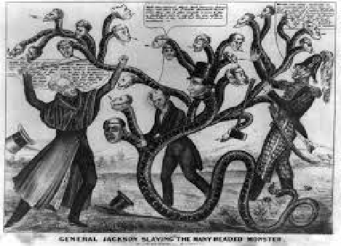
Jackson’s Battle with the Bank
Andrew Jackson:
“Many of our rich men have not been content with equal protection and equal benefits, but have besought us to make them richer by act of Congress… We must make a stand against any prostitution of our government to the advancement of the few at the expense of the many…”

Slide 12
Jackson Pays off America’s Debt?
Andrew Jackson is the first and only President to pay off the National Debt. A feat that no other president has ever come close to achieving.

Slide 13
Nullification Crisis
In 1828, the Federal Government passed the “tariff of abominations” that helped out American Merchants and the Federal Government, but hurt farmers in South Carolina.
In 1832, South Carolina created a doctrine known as the “Constitutional theory of State Nullification.”
They argued a state has the right to nullify federal laws that it deems unconstitutional and to secede from the Union if it wants to.

Slide 14
Question
Would Nullification have made the States or the Federal Government stronger?

Slide 15
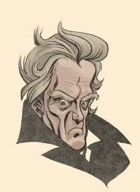
Jackson’s Reply
“I consider, then, the power to annul a law of the United States, assumed by one State, incompatible with the existence of the Union, inconsistent with every principle on which the constitution was founded, and destructive of the great object for which it was formed.”

Slide 16
Resolution of Crisis
Andrew Jackson takes a firm stand against State Nullification.
He quick response, his appeal to the South Carolinian people, and his threats forced them to abandon the principle of State Nullification.

Slide 17
Lasting Effects of Jackson
Jackson greatly expanded Presidential Power with Presidential Veto and Spoils System.
End of America’s National Bank: Some historians have suggested that this action may have deeply worsened, if not caused, the depression of 1837.
Jackson Paid off America’s debt, making America financially independent from the World.
He held the Union together, although he did not resolve the core issues behind Nullification. South Carolina would do the same thing in 1860 and helped cause the Civil War.

Slide 18
Was Jackson a Good or Bad President?
Expands Presidential Power (Presidential Veto and Spoils System)
Kitchen Cabinet
Destroys National Bank
Pays off Debt
Ends Nullification Crisis

